Slide 1
Improving Text-to-Image Coherence with CLIP-based Re-ranking
Tanmay Mittal -220101099
Tanvi Doshi - 220101102

Slide 2
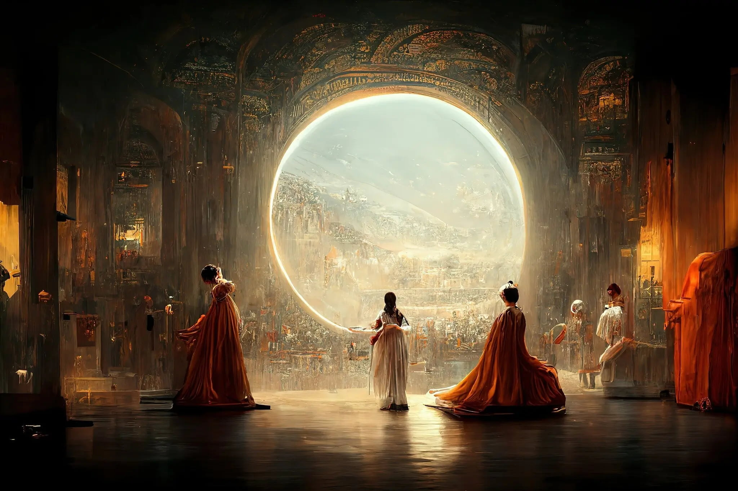
Introduction
Text-to-image diffusion models like Stable Diffusion, DALL·E 3, and Midjourney have transformed creative content generation.
Théâtre D’opéra Spatial
Notes:
-In recent years, text-to-image diffusion models like Stable Diffusion, DALL·E 3, and Midjourney have transformed creative content generation. These models can turn a short sentence into highly realistic and imaginative visuals — a feat that was nearly impossible a few years ago.
-In 2022, a digital artwork titled “Théâtre D’opéra Spatial”, generated using Midjourney, won a state art fair competition, sparking global discussions on the role of AI in creativity.

Slide 3
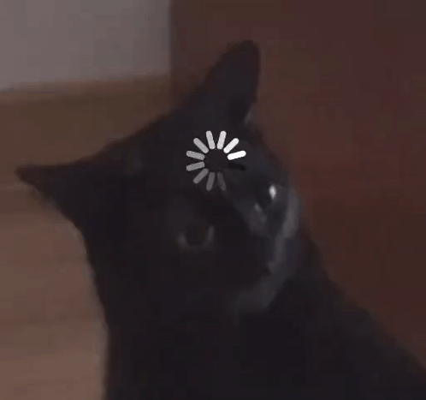
Motivation : Fails for complex prompts
Attributes
Spatial Arrangement
Object Count
World Knowledge/ Physics
Notes:
"So, where do these amazing models fail? They struggle when prompts get complex."
"They often get confused by a few key things:"
Spatial Arrangement: Confusing concepts like 'left' and 'right'.
Object Count: They can't count reliably.
World Knowledge & Physics: They often default to what's "normal" instead of what was asked.

Slide 4
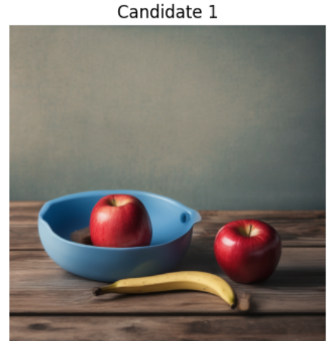
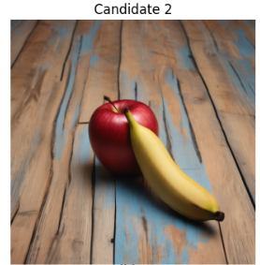
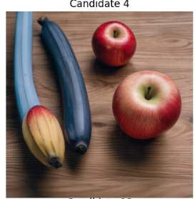
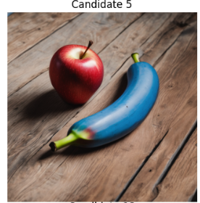
“A high-quality photo of a red apple sitting to the left of a blue banana on a wooden table”
Notes:
This lack of reliability means users must generate dozens of images and manually pick one that matches the prompt.
The process becomes tedious and inefficient, especially for designers, educators, and AI artists who rely on precision.

Slide 5
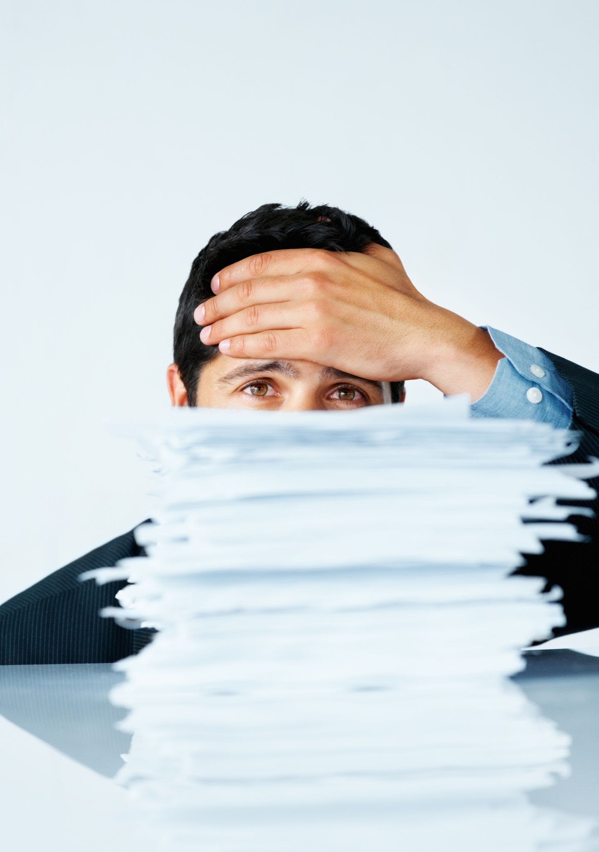
Frustrating User Experience
Slow Generation Times: The model requires significant time to produce a single image.
Manual Curation Required: Users must personally inspect every output to find a suitable one.
Inefficient and Tedious Process: The combination of waiting and manual sifting leads to a frustrating experience.
Notes:
So, these model failures we've talked about lead directly to a frustrating user experience. The tedious cycle of wait, check and repeat is what we want to eliminate

Slide 6
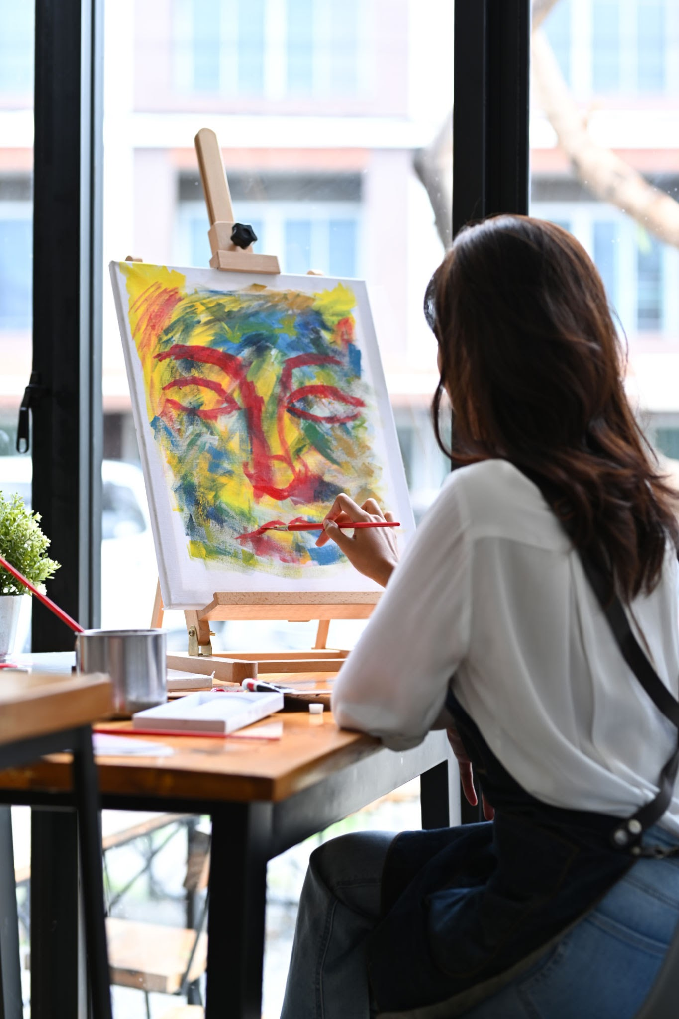
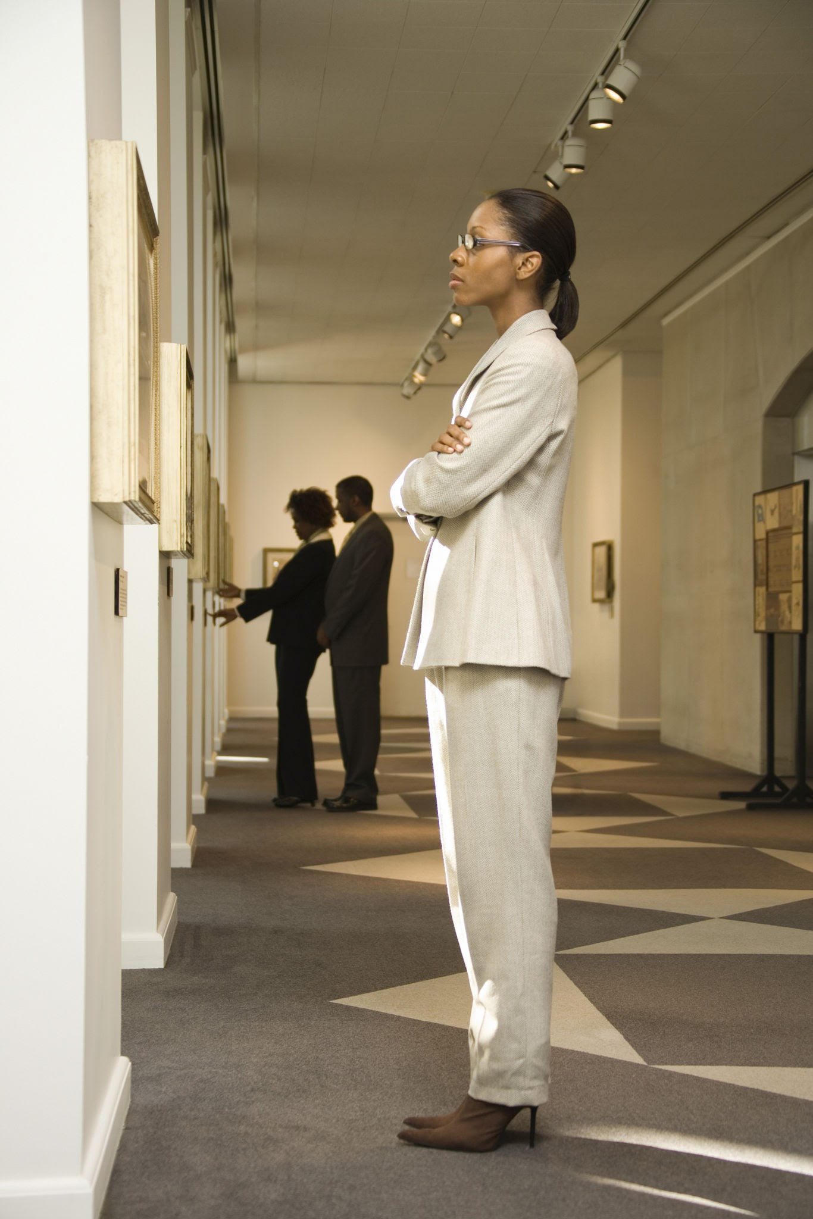
Our Solution
Idea is to automate the process of selecting the image that best suits the text prompt.
THE ARTIST
THE ART CRITIC
Stable Diffusion
CLIP
Generates multiple candidate images for a given prompt.
Scores each image based on how well it aligns with the original text.
Notes:
Why This Approach Works:
CLIP is trained on millions of image–text pairs, learning to connect visual and linguistic meaning.
By combining the creativity of diffusion models with the discriminative power of CLIP, we get the best of both worlds — high-quality and prompt-consistent outputs.
The system automatically selects the image with the highest semantic similarity — the one that best “understands” the prompt.

Slide 7
Foundational Models
“High-Resolution Image Synthesis with Latent Diffusion Models” (Rombach et al., CVPR 2022)
Introduced a latent space, a compressed representation of images, which drastically reduced computation without losing visual quality.
The model is trained to iteratively denoise latent representations, gradually turning random noise into a coherent image that matches the input text.
“Learning Transferable Visual Models from Natural Language Supervision” (Radford et al., ICML 2021 (OpenAI))
The CLIP paper introduced a new way to train vision models — not by labeling images manually, but by learning from millions of image–caption pairs found online.
CLIP consists of two encoders - a text encoder that converts a sentence into a text embedding and an image encoder that converts an image into an image embedding.
Both embeddings live in a shared semantic space — meaning related image-text pairs lie close together.
Notes:
Encoder -> latent space -> diffusion(unet)-> decoder
Zero shot transfer

Slide 8
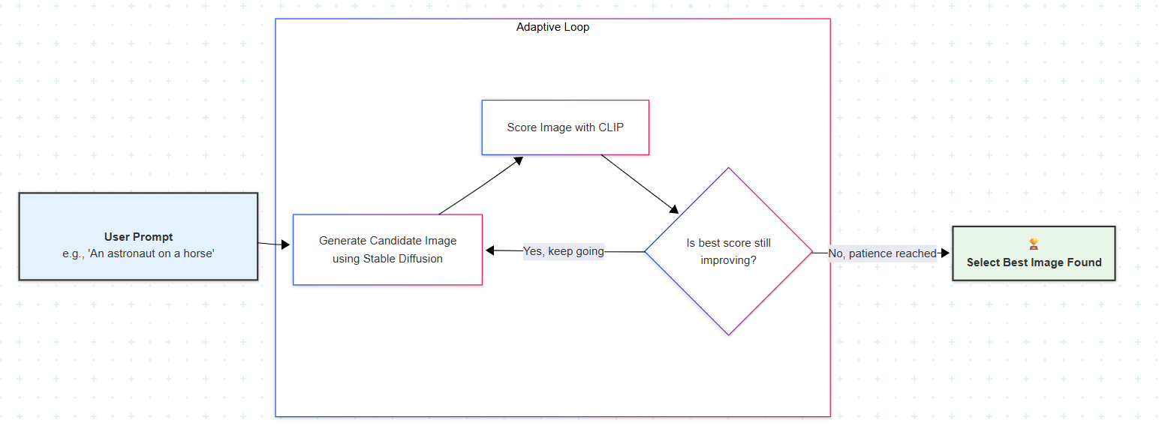
Pipeline

Slide 9
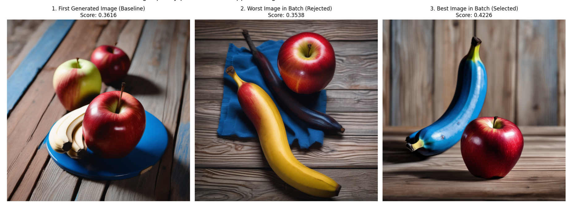
Experiments & Results
Prompt: “A high-quality photo of a red apple sitting to the left of a blue banana on a wooden table”
Result:
Generated 16 images, with patience level 5 and obtained a much improved image

Slide 10
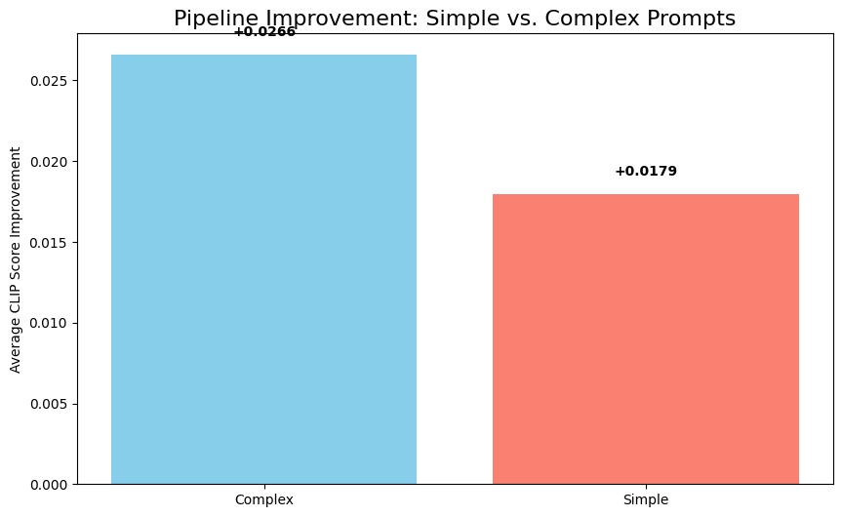
Experiments: Simple prompts VS complex prompts
6 Simple prompts and 6 complex prompts, to see how much improvement the model shows in these.
Notes:
In general more improvements was seen for complex prompts then simple prompts, but to get those improvements, the model had to run for longer times, and the chances of generating correct image is less.

Slide 11
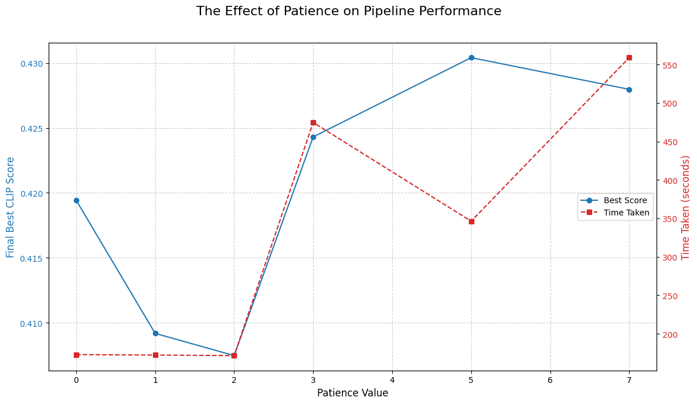
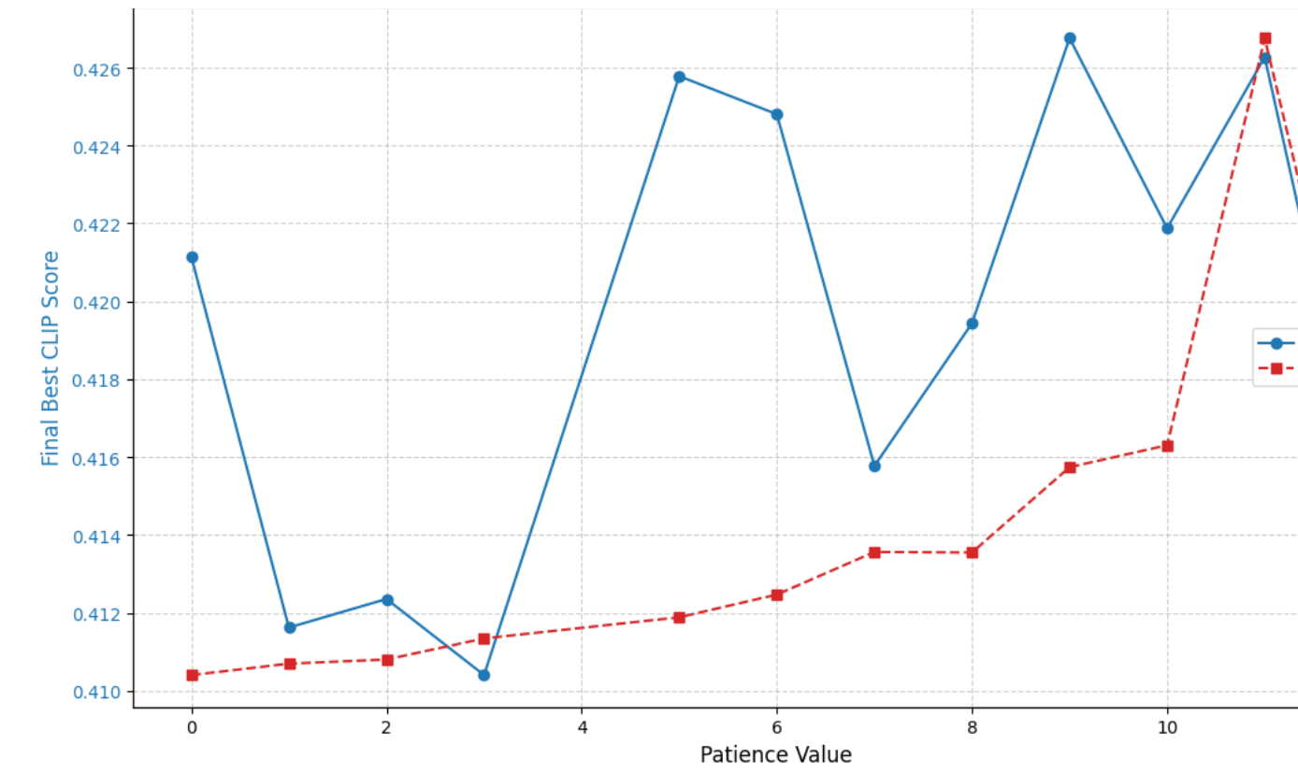
Experiments: Hyperparameters
Notes:
In general, time taken increases on increasing the patience value. On the other hand increase in the score is marginal.

Slide 12
Future Work
Ensemble of Judges
Feedback from CLIP to diffusion model
Parallelisation of generation and scoring

Slide 13

THANK YOU
Link to codes - https://www.kaggle.com/code/tanmay7404/minor-final-tanmay-tanvi

